Slide 1
Chapter 9 Chemical Kinetics
Wilt Gu

Slide 2
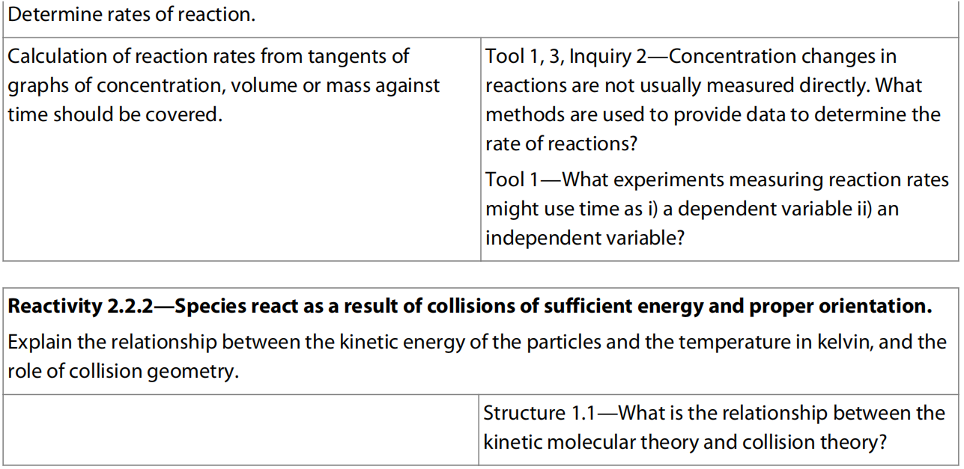
9.1 Collision theory and rates of reaction

Slide 3
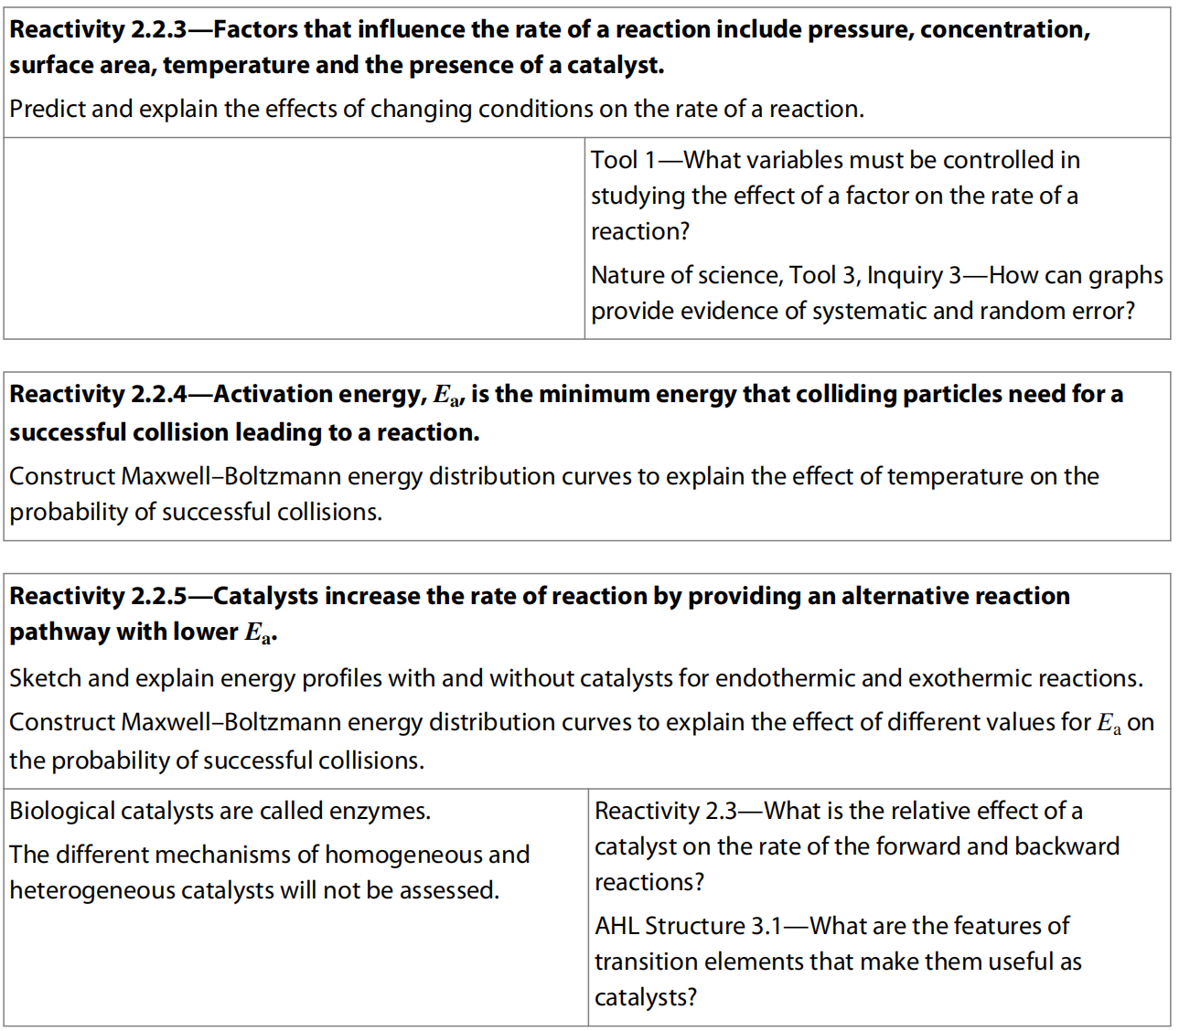

Slide 4

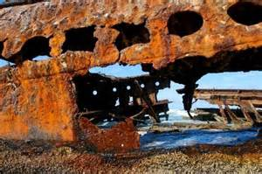
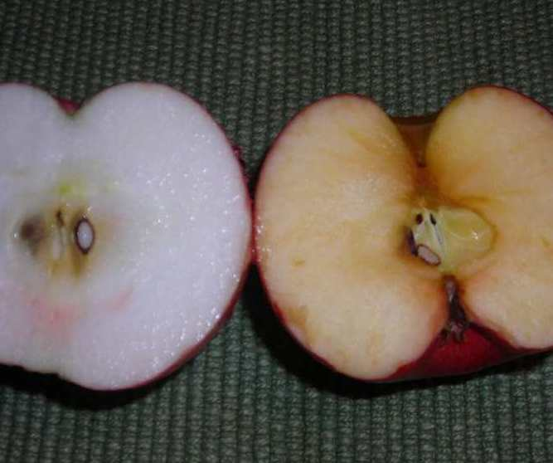
Different chemical reactions occur at different rates

Slide 5
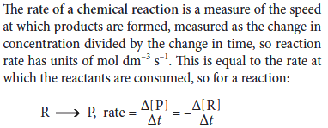
Quantification of Rates of reaction

Slide 7
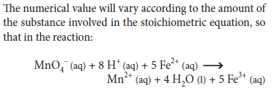
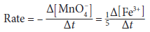

Slide 8
a A + b B → c C + d D
Rate of reaction = rate of disappearance of reactants
1
Δ[A]
1
Δ[B]
= -
= -
a
Δt
b
Δt
= rate of appearance of products
1
Δ[C]
1
Δ[D]
=
=
c
Δt
d
Δt

Slide 9
Practice
2 Fe³⁺(aq) + Sn²⁺ → 2 Fe²⁺(aq) + Sn⁴⁺(aq)
Find the relation among these:
Δ[Sn⁴⁺]
Δ[Fe²⁺]
Δ[Fe³⁺]
Δt
Δt
Δt
Δ[Sn⁴⁺]
1
Δ[Fe²⁺]
1
Δ[Fe³⁺]
=
= -
Δt
2
Δt
2
Δt

Slide 10
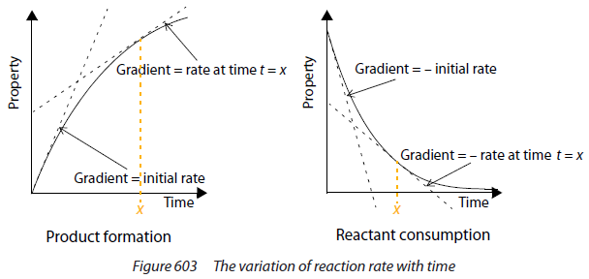
Measuring the rate

Slide 13
Techniques for measuring reaction rates
Any property that changes between the start and end of the reaction can in principle be used.

Slide 14
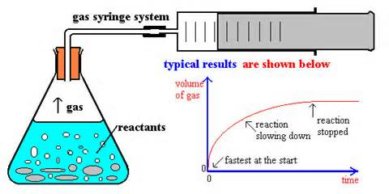
1. Change in volume of gas produced
Method 1:

Slide 15
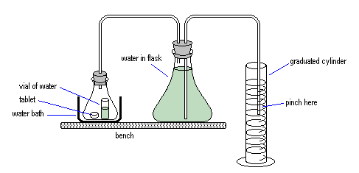
Method 2:

Slide 17
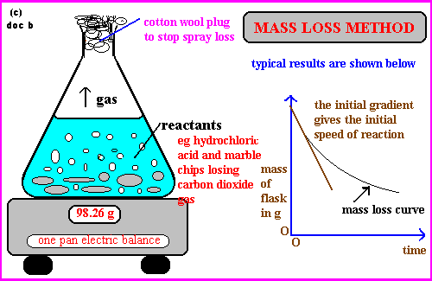
2. Change in mass

Slide 18
3. Change in transmission of light: colorimetry/spectrophotometry

Slide 19
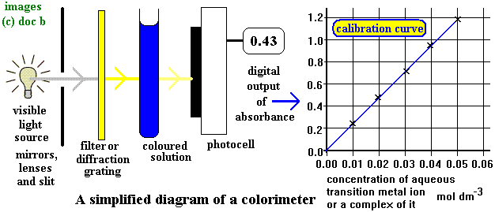

Slide 21
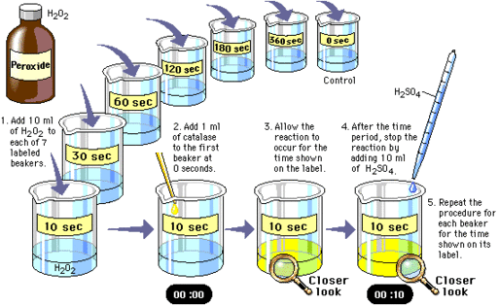
4. Change in concentration measured using titration
Enzyme
H₂O₂ O₂ + H₂O

Slide 22
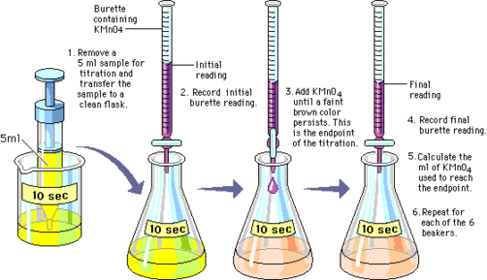
Enzyme
H₂O₂ O₂ + H₂O

Slide 24
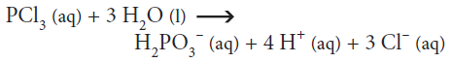
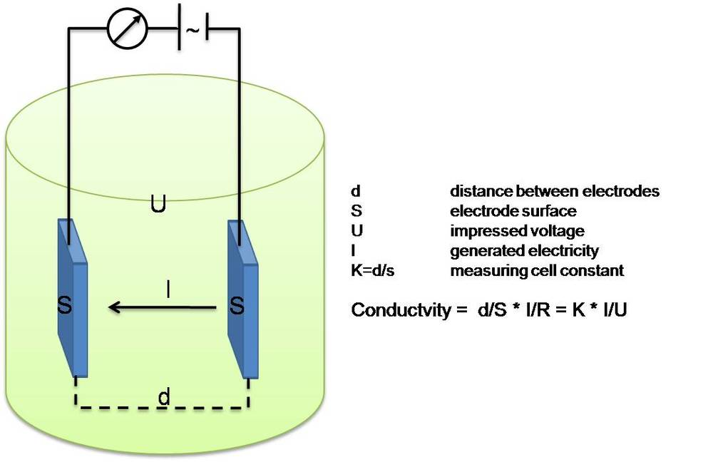
5. Change in concentration measured using conductivity

Slide 25
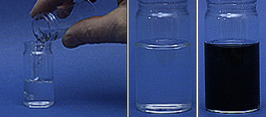
6. Non-continuous methods of detecting change during a reaction: ‘clock reactions’
IO₃–(aq) + 3HSO₃– (aq) → I– (aq) + 3SO₄²⁻ (aq) + 3H⁺ (aq) (eq. 1)
IO₃⁻ (aq) + 5I⁻ (aq) + 6H⁺(aq) → 3I₂ (s) + 3H₂O(l) (eq. 2)
I₂ (s) + Starch(aq) → I₂ -Starch(aq) (eq. 3)
Show video

Slide 26
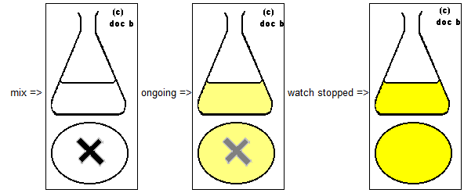
Plot rate of reaction (1/time) Vs. Concentration Or Temperature you varied

Slide 27
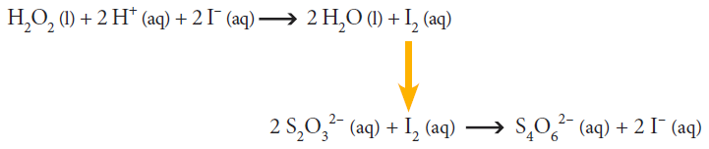
Clock techniques
Other clock reactions
2 I⁻ + S₂O₈²⁻ → I₂ + 2 SO₄²⁻ (slow)
I₂ + 2 S₂O₃²⁻ → 2 I⁻ + S₄O₆²⁻ (fast)

Slide 28
Other Clock reactions
1. Sodium pyrosulfite reacts with water to form sodium bisulfite:
Na₂S₂O₅ + H₂O → 2 NaHSO₃
2. Sodium bisulfite reduces iodate ion into iodide ion:
IO₃⁻ + 3 HSO₃⁻ → I⁻ + 3 SO₄²⁻ + 3 H⁺
3. With the increasing concentration of iodide ion, mercury (II) ion reacts with it to form orange precipitate:
Hg²⁺ + 2 I⁻ → HgI₂ (s)
4. The rest of iodide ion reacts with iodate ion to form element iodine, which reacts with starch to give dark blue (almost black) color:
IO₃⁻ + 5 I⁻ + 6 H⁺ → 3 I₂ + 3 H₂O
P.S.: The Old Nassau reaction or Halloween reaction is a chemical clock reaction in which a clear solution turns orange and then black. This reaction was discovered by two undergraduate students at Princeton University researching the inhibition of the iodine clock reaction (or Landolt reaction) by Hg²⁺, resulting in the formation of orange HgI₂. Orange and black are the school colors of Princeton University, and "Old Nassau" is a nickname for Princeton, named for its historic administration building, Nassau Hall.

Slide 29
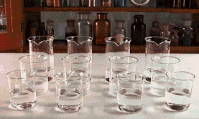

Slide 31
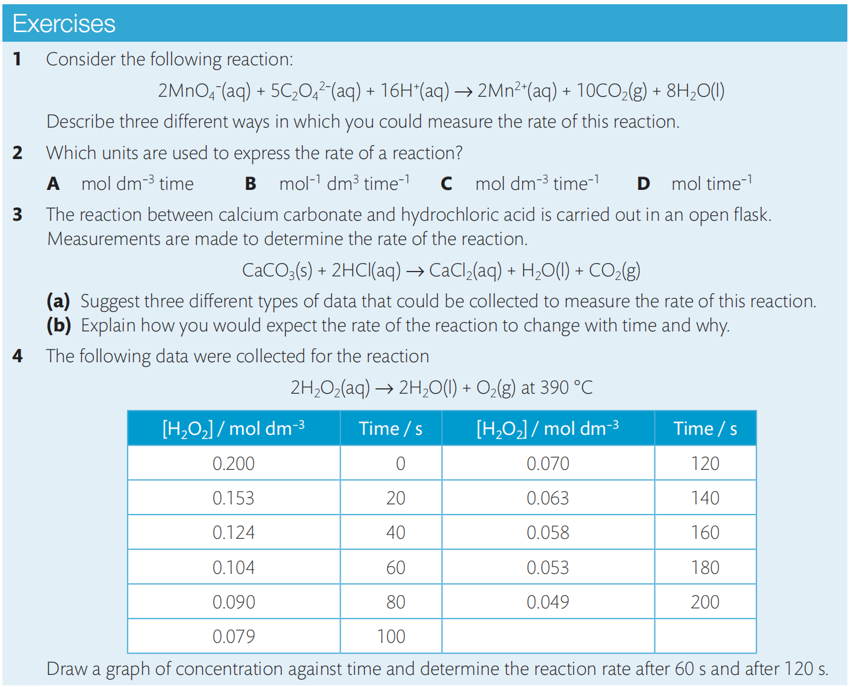

Slide 32
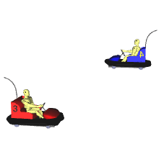
Collision theory
Two species (molecule, ion, or atom) can only react together if they come into contact with each other.
They first have to collide, and then they MAY react.

Slide 33
Why "may react"?
Collision isn't enough for the two species to react
They have to collide with the correct orientation.
---Steric factor
They have to collide with enough energy for bonds to break, and overcoming the repulsion between e⁻ clouds.
--- Energetic factor

Slide 34
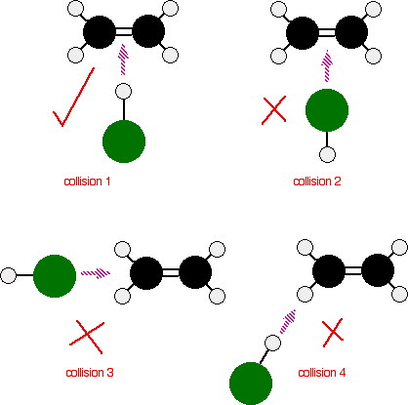
Collision-Steric factor

Slide 35
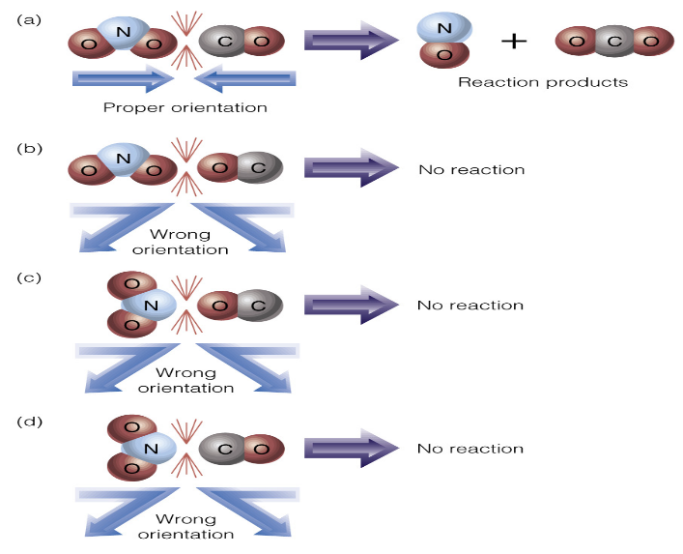
Collision-Steric factor

Slide 36
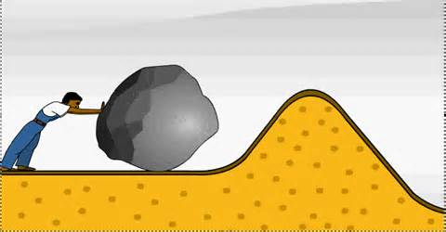
Collision-energetic factor
Even if the species are orientated properly, you still won't get a reaction
unless the particles collide with a certain minimum energy
called the activation energy (E_{a}) of the reaction.

Slide 37
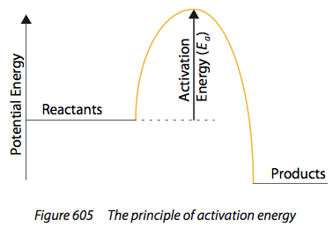
Collision-energetic factor
Practice labeling E_{a} for Exo- and Endothermic reaction in energy level diagram

Slide 38
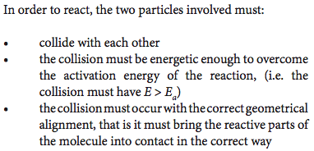
Collision theory

Slide 39
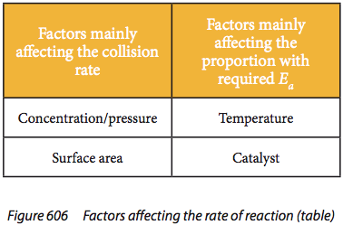
Factors affecting reaction rate
frequency

Slide 40
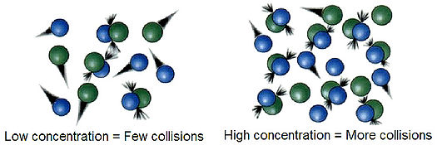
Effect of Concentration/pressure

Slide 41
Increasing the concentration of reactants increases the rate of reaction. This is because as concentration increases, the frequency of collisions between reactant particles increases. The frequency of successful collisions therefore increases too.
For reactions involving gases, increasing pressure increases the rate of reaction. This is because the higher pressure compresses the gas, effectively increasing its concentration. This will increase the frequency of collisions.

Slide 42
Effect of surface area
Slow
Very fast

Slide 43
Decreasing the particle size increases the rate of reaction.
This is important in heterogeneous reactions where the reactants are in different phases, such as a solid reacting with a solution.
Subdividing a large particle into smaller parts increases the total surface area and therefore allows more contact and a higher probability of collisions between the reactants.

Slide 44
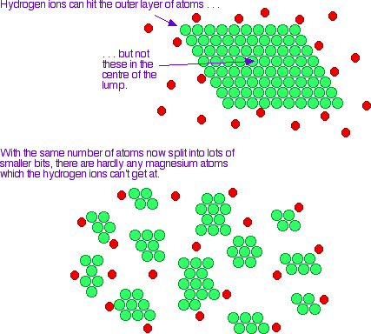
Effect of surface area

Slide 45
Effect of temperature
Because of the key role of E_{a} in deciding whether a collision will result in a reaction, it would obviously be useful to know what sort of proportion of the particles present have high enough energies to react when they collide.

Slide 46
Effect of temperature
The Maxwell-Boltzmann Distribution
In any system, the particles present will have a very wide range of energies. For gases, this can be shown on a graph called the Maxwell-Boltzmann Distribution which is a plot of the number of particles having each particular energy.

Slide 47
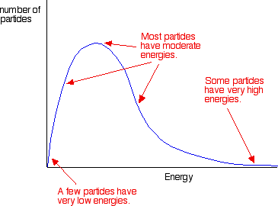
The Maxwell-Boltzmann Distribution
The area under the curve is a measure of the total number of particles present.
The graph only applies to gases, but the conclusions that we can draw from it can also be applied to reactions involving liquids.

Slide 48
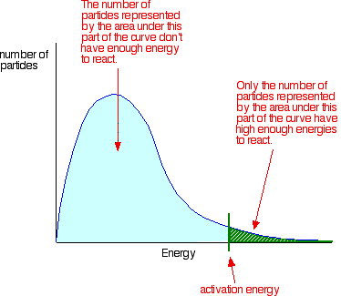
The Maxwell-Boltzmann Distribution
Remember that for a reaction to happen, particles must collide with energies equal to or greater than the E_{a} for the reaction:

Slide 49
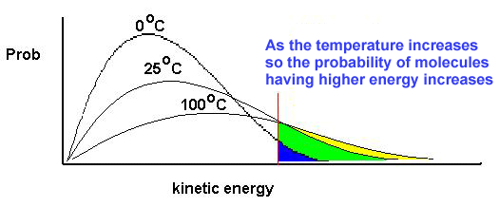
Effect of temperature
Show Maxwell-Boltzman model

Slide 50
Effect of temperature
So, as temperature increases, there is an increase in collision frequency due to the higher kinetic energy, but more importantly there is an increase in the frequency of collisions involving particles with the necessary activation energy to overcome the activation energy barrier.
Consequently, there is an increase in the frequency of successful collisions and so an increase in the rate of reaction.
Many reactions double their reaction rate for every 10℃ increase in temperature.
In section 16.2 of this chapter, we will explore this further through a study of the mathematical relationship between temperature and rate of reaction.

Slide 51
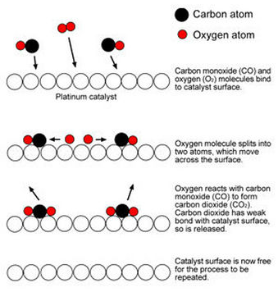
Effect of Catalyst

Slide 52
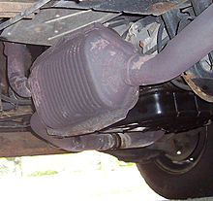
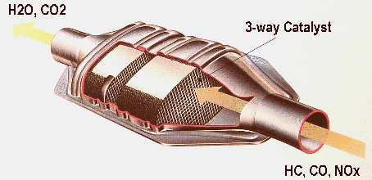
Effect of Catalyst
Catalytic Converter

Slide 53
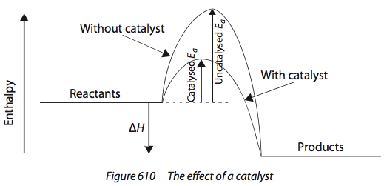
Effect of Catalyst

Slide 54
A catalyst is a substance that increases the rate of a chemical reaction without itself undergoing permanent chemical change.
Most catalysts work by providing an alternate route for the reaction that has a lower activation energy.
This means that without increasing the temperature, a larger number of particles will now have values of kinetic energy greater than the activation energy, and so will be able to undergo successful collisions.

Slide 55
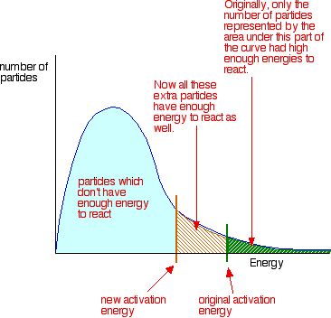
Effect of Catalyst

Slide 56
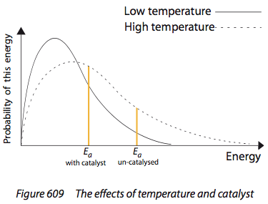
Effect of Temperature & Catalyst

Slide 57
Importance of Catalyst in Industry
Catalysts bring about an equal reduction in the activation energy of both the forward and the reverse reactions, so they do not change the position of equilibrium or the yield (Chapter 7).
However, because of their ability to increase the rate of reactions, they influence the rate of formation of product and so play an essential role in the efficiency of many industrial processes.
Without catalysts, many reactions would proceed too slowly, or would have to be conducted at such high temperatures that they would simply not be worthwhile.

Slide 58
Biological Catalysts – Enzymes
Every biological reaction is controlled by a catalyst, known as an enzyme.
Thousands of different enzymes exist as they are each specific for a particular biochemical reaction.
Enzymes are finding increasingly widespread uses in many domestic and industrial processes, such as biological detergents, acting as ‘biosensors’ in medical studies, cheese making, etc.
Enzyme kinetics is discussed further in Chapter 13, Biochemistry.

Slide 59
The importance of Catalysis in green chemistry
Catalysis is also an important aspect of Green Chemistry, which seeks to reduce the negative impact of chemical processes on the environment.
Catalysts can replace stoichiometric reagents, and can greatly enhance the selectivity of processes.
As they are effective in very small quantities and can frequently be reused, catalysts do not contribute to the chemical waste, and so they increase the atom economy.
Some examples of Green Chemistry catalysts in organic synthesis reactions are discussed in Chapter 10.

Slide 60
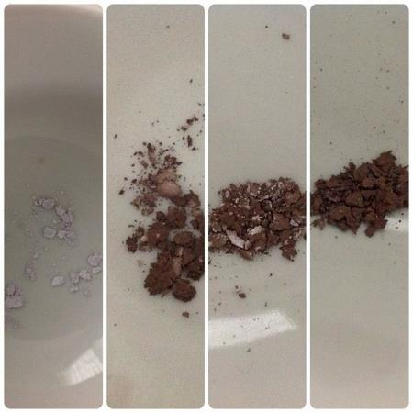
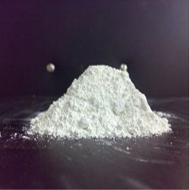
Effect of Light
AgCl (s) Ag (s) + Cl₂ (g)
Darkening of AgCl with exposure to light

Slide 61
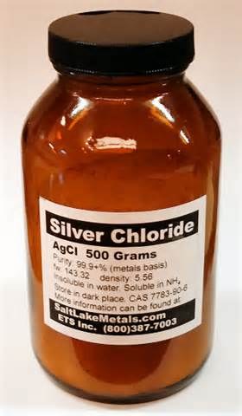
Effect of Light
AgCl (s) Ag (s) + Cl₂ (g)
Store in brown glass containers

Slide 62
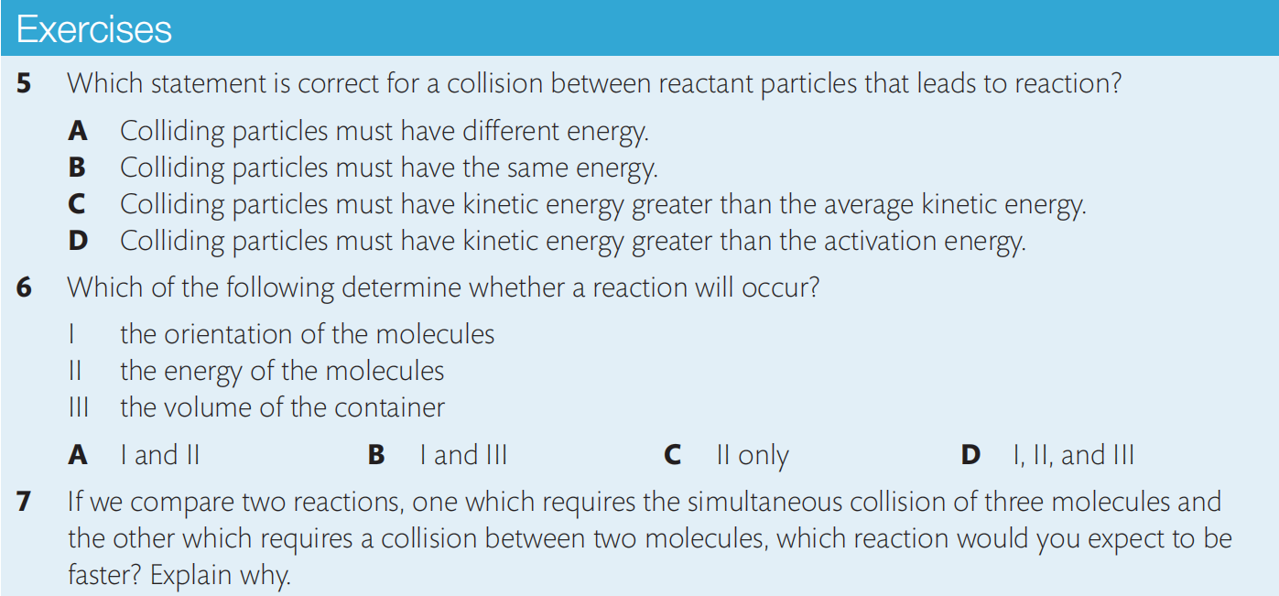
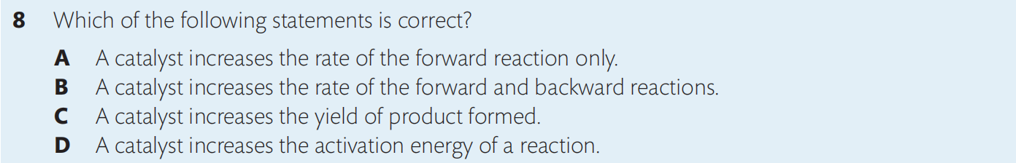

Slide 63
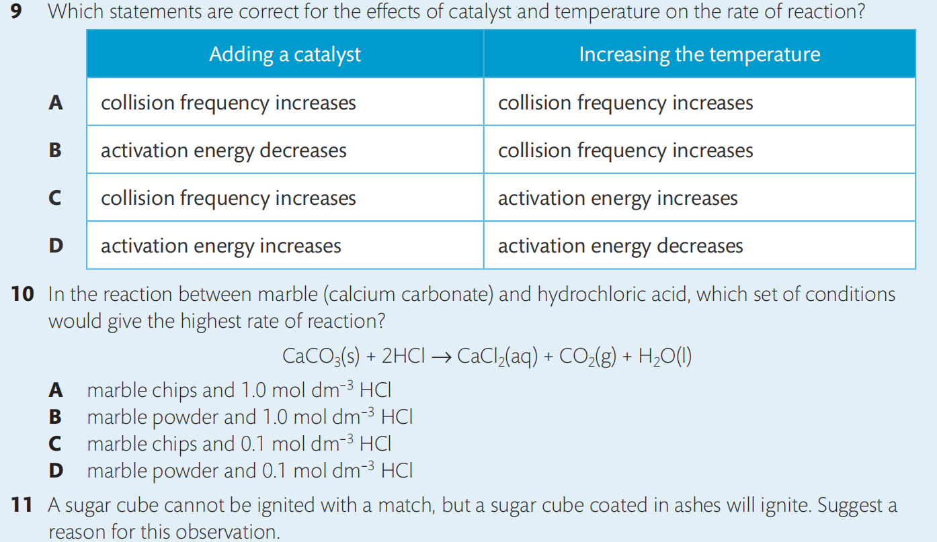
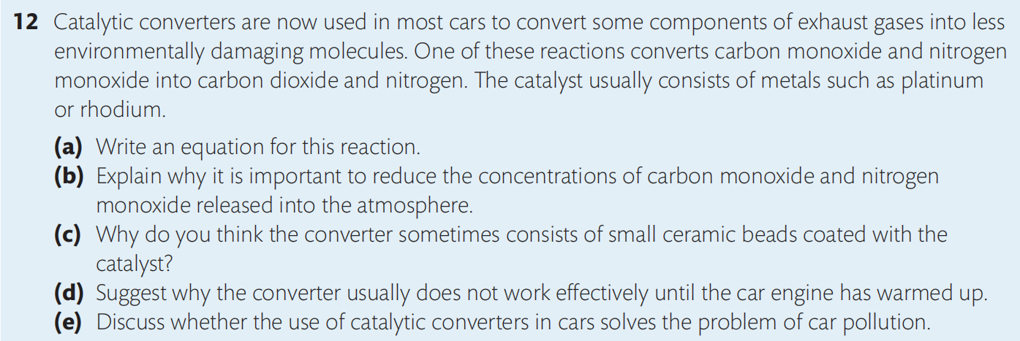

Slide 64
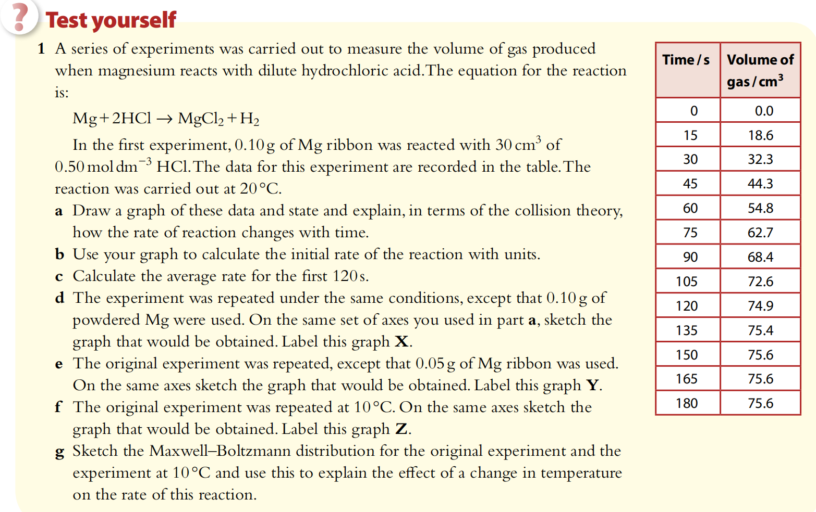

Slide 65
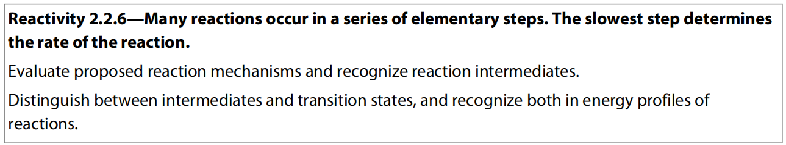
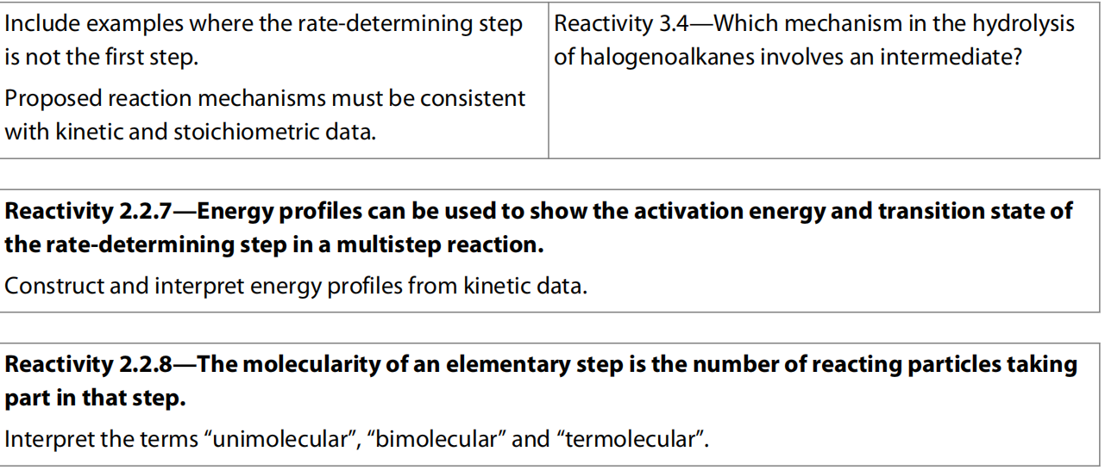
9.2 Rate expression and reaction mechanism (Higher Level)

Slide 66
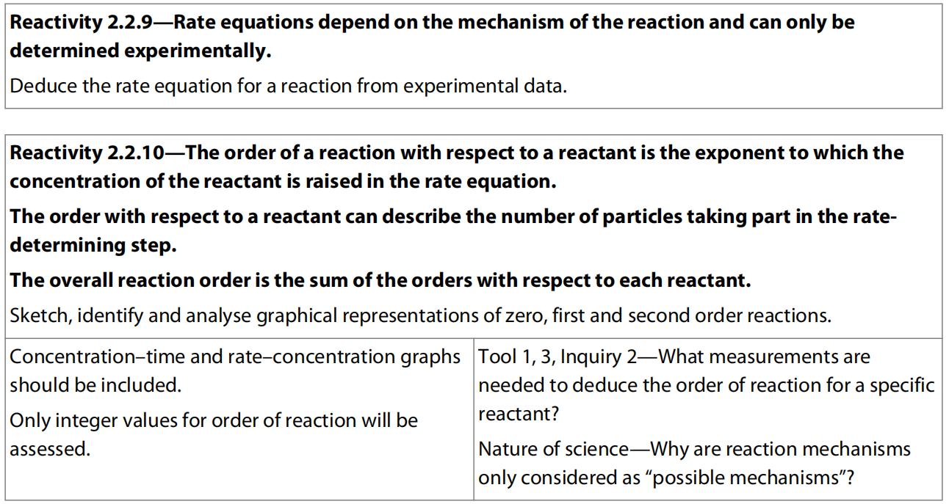

Slide 67

or rate law

Slide 68
Determining the order of reactions
Initial rates method
If changing the concentration of A has no effect on the rate, the reaction must be zero order with respect to A.
If changes in the concentration of A produce directly proportional changes in the rate of the reaction, the reaction must be first order with respect to A. In other words, in a first-order reaction, doubling the concentration of A leads to doubling of the rate, tripling [A] leads to a tripling of the rate, etc.
If changes in the concentration of A lead to the square of that change in the rate of the reaction, then the reaction must be second order with respect to A.
For example, doubling [A] would lead to a four-fold increase in the rate of reaction, and tripling [A] would lead to a nine-fold increase in the rate.

Slide 69


Slide 70

Practice
Rate=k [A]^{x}[B]^{y}[C]^{z}
Rate = k [A]¹[B]⁰[C]² = k [A][C]²

Slide 71

Unit of rate constant

Slide 72
Zero order reaction

Slide 73
First order reaction

Slide 74
Second order reaction

Slide 76
Half-life
There is one additional feature of the concentration–time graph for the first-order reaction worth mentioning.
On these graphs, if we measure the time it takes for a concentration of reactant to decrease to half its original value, we find that this interval is independent of the starting concentration. This value, known as the half-life, t_{1/2}, for the reactant, is therefore a constant.

Slide 78

Gradient=rate of reaction

Slide 79

Gradient is halved when the Conc. Is halved

Slide 80


Slide 81

Half-life
First-order reaction has a constant half-life
Radioactive decay is 1st order reaction

Slide 82


Slide 83


Slide 84


Slide 85



Slide 86


Slide 87



Slide 88
Reaction mechanism
Many chemical reactions occur by a series of simple steps known as elementary steps, and the whole series is called the mechanism of the reaction.
The sum of the various steps of the mechanism must equal the balanced equation for the reaction

Slide 89
Often the products of a single step in the mechanism are used in a subsequent step.
They exist only as reaction intermediates, not as final products.
The sum of the individual steps (called elementary steps) in the mechanism must equal the overall equation for the reaction.
Intermediates and catalysts are shown on both sides so are needed to be cancel out.

Slide 90
The term molecularity is used in reference to an elementary step to indicate the number of reactant species involved. So unimolecular refers to an elementary step that involves a single reactant particle, bimolecular refers to an elementary step with two reactant particles.
In the NO₂ + CO reaction above, both the elementary steps are bimolecular.
Because of collision theory, and the extremely low probability of more than two particles colliding at the same time with sufficient energy and in the correct orientation, termolecular reactions (those that involve three reactant particles) are rare.

Slide 91

Two fundamental process
that can occur to bring about a chemical reaction
Whether a particular reaction step is uni- or bi-molecular, is known as the molecularity of that reaction step.

Slide 92
The rate-determining step is the slowest step in the reaction mechanism
In chemical reactions that involve several steps, the overall rate of reaction is determined by the slowest step in the sequence.
This is therefore called the rate-determining step.
Products of the reaction can only appear as fast as the products of this elementary step.
So the rate-determining step determines the overall rate of the reaction.

Slide 94
The two maxima represent the transition states and the minimum between them represents the intermediate species present after the first step.
In this example, the energy of the transition state of the first step is higher than that of the second step, so the first step will be the slowest step and will determine the rate of the reaction.
The activation energy for the overall reaction is equal to the activation energy of this rate-determining step.
Catalysts usually alter the reaction mechanism by providing an alternate pathway for the rate-determining step that has a lower activation energy.

Slide 95


Intermediates V.s. transition states

Slide 96
The rate expression for an overall reaction is determined by the reaction mechanism
As the rate of reaction depends on the rate of the rate-determining step, it follows that the rate expression for the overall reaction must depend on the rate law for the rate-determining step.
Because the rate-determining step is an elementary step, a single molecular event, its rate law comes directly from its molecularity.
Collision theory informs us that the concentration of each reactant in the rate-determining step must appear in the rate law for that step, raised to the power of its stoichiometric coefficient in the equation.

Slide 97
The table below shows the relationship between equations for elementary steps and their rate laws.

Slide 98
Practice:

Slide 99
When the rate-determining step is not the first step in the mechanism, it is a bit more complicated as in this case its reactant concentrations will depend on an earlier step, so this must also be taken into account.

Slide 100
Practice:

Slide 101

Role of Rate expression
Determining the rate expression for a reaction will help to identify the rate determining step and this will eliminate many possible mechanisms for the reaction.
What are the possible mechanisms ?

Slide 102

?
?
Note: Conc. of intermediate (X) never appears in the rate expression
?
?
?

Slide 103
Note: The rate expression can never prove that a particular mechanism is correct, but it can provide evidence that other possible mechanisms are wrong.

Slide 104



Slide 105


Slide 106


Slide 107



Slide 108


Slide 109

9.3 ARRenius Equation (Higher Level)

Slide 110
The rate constant K is temperature dependent
From the rate expressions, we know that the rate of reaction depends on two things: the rate constant, k, and the concentrations of reactants, raised to a power.
Since increasing temperature does not change the values of reactant concentrations, its effect must therefore be on the value of k.
So k is a general measure of the rate of a reaction at a particular temperature.

Slide 111
According to Collision theory, the effect of increasing temperature on reaction rate: principally by increasing the number of collisions that involve particles having the necessary activation energy, Ea, a greater proportion of collisions leads to reaction.
Maxwell–Boltzmann distribution curves can be used to show the changing distribution of kinetic energies with increasing temperature.

Slide 112

Maxwell-boltzmann distribution
Reaction occurs more rapidly at higher T

Slide 113
From this, we can predict that the value of the activation energy will determine the extent of the change in the number of particles that can react at higher temperature.
When the activation energy is large, a temperature rise will cause a significant increase in the number of particles that can react.
A low value for activation energy will mean that the same temperature rise will have a proportionately smaller effect on the reaction rate.
Thus the temperature dependence of k depends on the value of the activation energy.

Slide 114

Arrhenius equation
The expression indicates that the k depends exponentially on T, which is why T has such a large effect on k

Slide 115



Using the Arrhenius equation to calculate activation energy

Slide 116
Practice:

Slide 117


Slide 118
Solving simultaneous equations
Activation energy can also be calculated from values of the rate constant, k, at only two temperatures. The formula is derived as follows:

Slide 119
example:

Slide 120


Slide 121
So the Arrhenius equation enables us to calculate the activation energy of a reaction.
The relationship also supports the observation that increasing the temperature by 10 K (which is of course the same as 10℃) doubles the value of the rate constant and hence the rate of reaction when the activation energy is in a fairly narrow range around 50 kJ mol^{–1}. This is the situation for a large number of common reactions.
But for reactions that have particularly large or particularly small values for activation energy, then we find that the rise in temperature has a very different effect on the rate constant.
This is applied in materials research, where the temperature sensitivity of reactions is crucial. For example, research into the temperature dependence of memory devices such as flash drives is based on the Arrhenius equation, and helps manufacturers predict the memory retention under different conditions.

Slide 122


Slide 123


